Slide 1
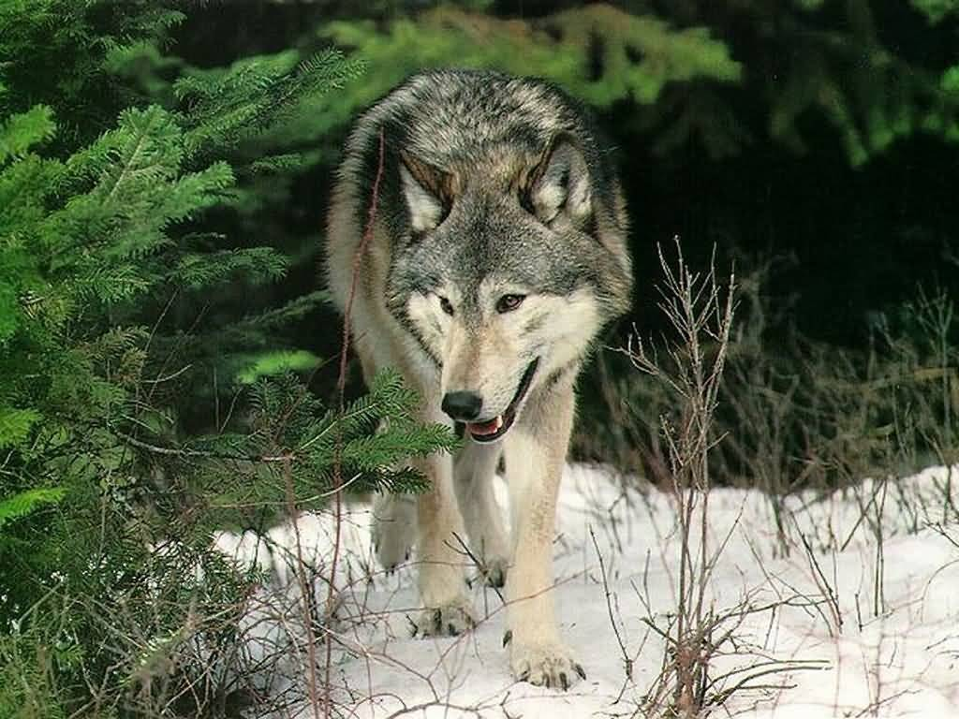
How do evaluation results contribute to public policy formation? The case of Swedish wolf hunting
EEEN-forum 9-10 Feb. 2012
Dr. Kerstin Åstrand
Finnish Environment Institute/
Swedish Environmental Protection Agency

Slide 2
Aim of the Study
Examine the role of assessments and evaluations in the formation of the Swedish policy on wolf hunting over time.

Slide 3
Starting points
Often argued that evaluation results should be used to improve policy making and implementation – Function to induce learning and development.
Sweden is known to have a tradition of evidence-based policy making and to be a forerunner in environmental policy.
EU Commission has initiated formal proceedings against Sweden for failure to comply with EU legislation.

Slide 4
Definition of Evaluation
“An analytical inquiry based on collecting and analyzing evidence, drawing on conclusions and recommendations from this evidence." (Valovirta, 2002)

Slide 5
Research Approach
A case of policy formation
Central government level in focus (government, committees & agencies)
Document study
2 bills
2 committee reports
EPA studies
Research reports
Parliament
Government bill
Ministry
Agencies
(Swedish EPA)
Committees of Inquiry

Slide 6
Conceptual Framework
Use categories | Characteristics
Instrumental | Evaluation findings are turned into action: Decision to implement new policy programmes/measures, adjust existing ones
Conceptual | Evaluation findings lead to: Increased awareness New comprehension Change of attitudes No immediate action taken
Legitimizing | Evaluation results used to: Mobilize support for positions Weaken position held by opponents Justify decision

Slide 7
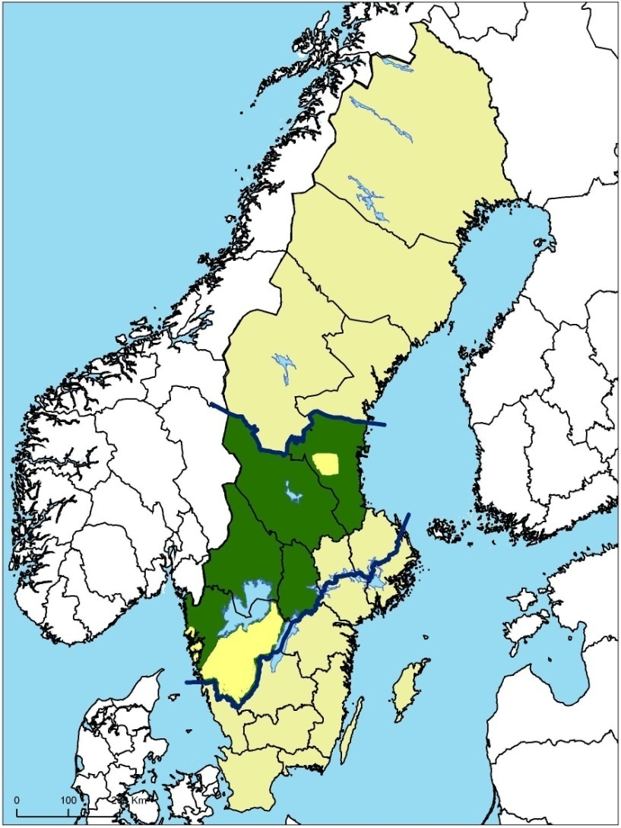
The Wolves – where and how many?
Extinct in the 1970s;
Recovery since the 1980s – Immigration from Finland/Russia;
About 200 wolves today;
Established in forests of central Sweden;
Allowed to spread within their natural range, expect for reindeer herding areas.
Notes:
The wolf was practically extinct in Sweden in the 1970s, and its recovery has started from a very narrow genetic base. This has resulted in inbreeding. In 25 years, only three wolves have entered the country, migrated down to mid-Sweden and bred.
In 2007, the situation improved when one wolf from the north-east european population settled in Gävleborg County and another in Norway. Some of the offspring of the Norwegian wolf have moved into Sweden. Additional wolves may have entered the country without reproducing.
Wolves can be found in a belt stretching from the western part of Västra Götaland County through Värmland, Örebro, Västmanland and Dalarna to Gävleborg County. A pack of wolves have an established territory in Stockholm County. In addition, there are a few wolves in southern Sweden and in the north. Parliament has decided that their status in reindeer areas should be managed so that organised reindeer husbandry is not rendered impossible.
The most recent report from the 2010/2011 census, issued on 19 January, shows that there have been 23 definite births of wolf litters in Sweden, as well as two probable ones. This means that there were about 210 to 230 wolves in Sweden before the licensed hunt began. The census runs from October to February.

Slide 8
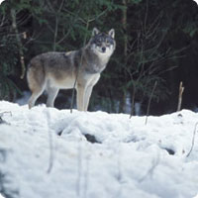
Protected Species
Aim of Swedish Predator Policy – Ensure the long-term survival of Sweden's large carnivores – brown bear, wolverine, golden eagle, lynx and wolf.
The long-term survival of the wolf in Sweden is not assured.
Population genetically isolated
Few wolfs have entered the country and bred
Inbreeding

Slide 9
First Policy Round
1997, the Swedish parliament orders to government to develop a comprehensive policy on predators.
1998, the Ministry of environment appoints a committee of inquiry. Final report in Jan. 2000.
2000 (Dec.), the government presents a bill on a comprehensive predator policy:
2001, the bill is passed by the Parliament.

Slide 10
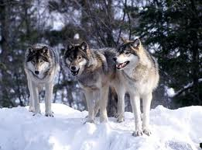
The Committee's Conclusions & Recommendations
To ensure long-term survival: minimum target for the wolf population:
20 reproductions, approximately 200 animals.
Scientists concluded that 500 wolves should be a minimum.
Argument for lower nb: Too drastic increase from the 60-75 wolfs.
Measures:
Tightened penalties for illegal hunting.
Increased research funding.
(Translocation mentioned as a possibility, but not a recommendation).

Slide 11
The Committee's Conclusions & Recommendations (2)
Negative economic impacts for the reindeer business
Conflicts man - wolf a reality (locally)
Conflicts local interest - national authorities
Attitudes towards wolves generally positive
Measures to minimise conflicts & prevent damage
Allow protective hunting
Reform on rules on compensation for damage (increase legitimacy for national policy measures among the Samis).
Information to the public

Slide 12
The Government Bill
Largely applied the goals and measures suggested by the Committee.
Changed the minimum target to an interim target

Slide 13
Second Policy Round
2006, Ministry of Environment appoints a committee of inquiry to assess the effects of the growing predator populations. Final report in Dec. 2007
2008 (Dec.), the interim target is met. The EPA is ordered to:
Investigate if management of the wolf population could be carried out by using other forms of hunting than protective hunting.
Propose measure that would genetically invigorate the Swedish wolf population.
2009, the government presents a bill on a new management of large carnivores in Sweden.
2010, bill passed in parliament

Slide 14
The Committee's Conclusions
Inbreeding still a major problem
Immigration from Finland limited (3 animals)
Illegal hunting major problem
Wolves continues to cause problems (attacks on reindeers and livestock).
Negative attitudes and conflicts still there

Slide 15
The Committee's Recommendations
To reduce conflicts:
Avoid high concentration of settlements.
Reform the administrative system: higher degree of local participation in wolf management would increase the legitimacy for the wolf and the authorities implementing the policy measures.
When interim target is met, freeze the growth until a new, decentralized management system is in place.
Measure: Increased used of protective hunting in combination with licensed hunting under the condition that the population grows.
To ensure long-term survival:
Improve methods for inventories
Translocation not recommended – weakened legitimacy

Slide 16
The EPA study on hunting
Protective hunting should be the principal form (easier to control)
If licensed hunting should be allowed:
Based on the conditions given by protective hunting
Should not lead to a stabilized population (not in line with the Habitat Directive)
Should be restricted and conditioned
Immigrated wolves and their off-spring should be spared
Artificial immigration as a mean to invigorate the population is not recommended – the effects too uncertain

Slide 17
The Government Bill 2009
People living in wolf areas should have a possibility to adjust to the presence of wolves.
The growth of the wolf population should be freezed until new impact assessment is presented.
The number of wolves should not exceed 210.
More important to genetically strengthen the population than having a larger, inbred population.
Licensed hunting as a complement to protective hunting is possible and should be possible already the winter 2009/2010).

Slide 18
Empirical Epilogue
The EPA authorized quota-based, licensed hunting of 27 wolves in 2010 (28 were killed) and of 20 in 2011.
Evaluation concluded that is was too soon to trace negative genetic effects.
2012 – increased protective hunting instead of licensed hunting.

Slide 19
The role of evaluation results
First policy round:
Scientific knowledge confirms the understanding of underlying problem: the wolf population is not sustainable
Scientific recommendations on population size is not followed.
Assessment of impacts on local societies contributed to understanding of the problems caused by the wolfs and conflicts are identified as a major problem.
Findings are used to improve existing measures and to formulate new ones, e.g. protective hunting.
But how scientific was the assessment?

Slide 20
The role of evaluation results
Second policy round
Social scientific knowledge used to form a new, decentralised management strategy.
Limited scientific evidence to back up the arguments used to allow licensed hunting – change attitudes, reduce conflicts and illegal hunting.
Decision to translocate wolves despite recommendations not to.

Slide 21
Tentative Conclusions
No pure instrumental use – findings are turned into action but the findings are adjusted and complemented along the way.
Conceptual use – probably. Increased awareness and comprehension regarding conflicts, turned into action.
Legitimizing use – findings from the committee reports and the EPA study used to justify licensed hunting.

